Slide 1
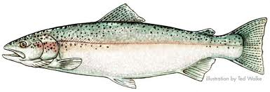
Steelhead in the Salinas River
An Overview of the Species, Historically and Currently, and Processes to Recovery

Slide 2
National Marine Fisheries Service
Devin Best – Natural Resource Management Specialist
“Home base” - San Luis Obispo County
Covered ESA listed species issues from Washington/Oregon to the California/Mexican border
Background in watershed restoration and community development and stewardship
NMFS Mission : Stewardship of living marine resources through science-based conservation and management and the promotion of healthy ecosystems
Current geography San Mateo, Santa Cruz, Monterey, and San Luis Obispo County – Primary focus on Salinas River

Slide 3
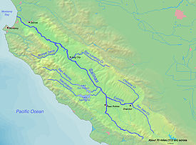
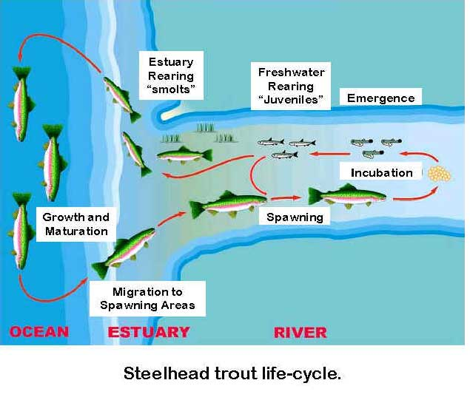
Steelhead in the Salinas: Historic
Lack of long-term documentation of steelhead in the Salinas River - sporadic presence surveys
John Otterbein Snyder (1913) earliest records of steelhead in the Salinas River and its tributaries (Nacimiento, San Antonio, Arroyo Seco Rivers).
Steelhead runs in the DPS averaged between 17,750 – 27,000 (Good et. al., 2005).

Slide 4
Current Status: Rapid Decline since 1960s
Status Review (Busby et al., 1996) steelhead abundance <100 in the Salinas River (= 2-5% of estimated historic run size remains)
Southern-Central California Coast (S-CCC) steelhead listed in 1997 as threatened under the Endangered Species Act (ESA).
      A majority (possibly all) of S-CCC steelhead populations are likely to be extinct within 50 years without serious intervention (Moyle et al. 2008)
Factors for listing:
  Alteration of natural stream flow patterns
  Physical impediments to fish passage
  Alteration of floodplains and channels
  Sedimentation
  Urban and rural waste discharges
  Spread and propagation of alien species
  Loss of estuarine habitat

Slide 5
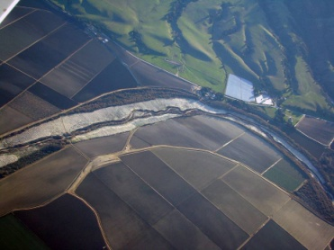
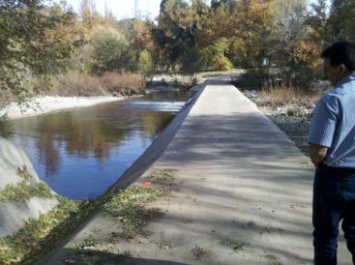
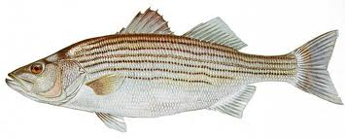
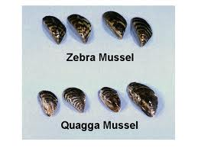
Issues in the Salinas River
Water Quality
      Salinas River 303(d) listed for:
        Pesticides
        Metals
        Nutrients
        Salinity/TDS/Chlorides
Channel complexity
      Floodplain disconnected by levees
      CMP activities clear vegetation in the mainstem for flood control
Barriers
      Additional minor barriers on tributary streams impede passage of adults and juveniles
Water Operations
      Reservoir operation for flood control and agriculture irrigation
      Groundwater recharge – seawater intrusion in Lower Salinas River
      Releases from Nacimiento and San Antonio Reservoirs modified in SVWP to improve habitat and passage conditions for steelhead
      Groundwater recharge
Biological
      Non-native species introduced
      Hatchery stocking program
      Harvest

Slide 6
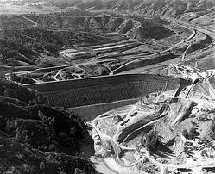
Habitat Reduction
3 Major Dams built from 1940-1960s
  Salinas Dam – 1944
  San Antonio – 1956
  Nacimiento – 1965
Fractured Habitat
  90-93% loss of critical spawning and rearing habitat in Nacimiento and San Antonio Rivers
  Salinas River mainstem considered a migratory corridor
  Upper Salinas – important for aiding and dispersal of species in DPS
Salinas Dam Spillway
Nacimiento Dam under construction 1959

Slide 7
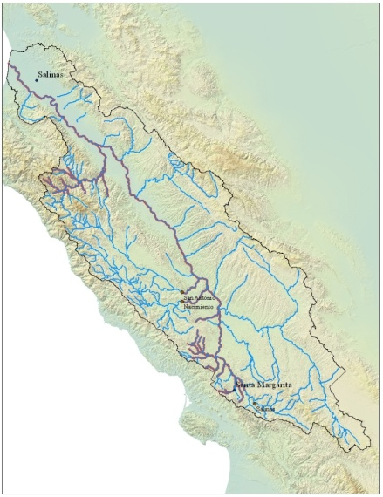
Historic vs. Current Steelhead Distribution in the Salinas River
Blue Line = Historic Distribution
Purple Line = Current Distribution

Slide 8
The importance of steelhead in our watershed(s)?
Steelhead are indicator species of watershed health
Declines in aquatic species (i.e. steelhead) indicate watershed dynamics remain dysfunctional, unbalanced
Common view of fisheries management is from top-of-bank to top-of-bank
    Definition of a watershed – area of land where surface water from precipitation converges to a single point
Entire watershed is connected
    Headwaters and upslope impacts increase sedimentation and contribute to poor water quality

Slide 9
The Ever-Changing Environment
Human population projected to increase
  SLO County Population ~330,000 by 2040 (currently 265,000)
  Monterey County ~610,00 by 2040 (currently 416,000)
Water Development
  Monterey County Groundwater 443,000 AFY
        Urban 85,000 AFY
        Agriculture 358,000
        Salinas River outflow to Pacific Ocean 249,000 AFY
  SLO County approximately 40,000 AFY
Climate Change
        Increased air temperature
        Decreased annual precipitation
Wildfire
        Frequency of fires reduced
        Total fire suppression results in greater accumulation of fuels
        Wildfires burn greater area and at higher temperatures
        Increased flood risk and sedimentation
Drought
        More frequent and longer lasting
        Greater strain on multiple uses of water (e.g. ag, municipal, industrial, fish/wildlife, etc.)

Slide 10
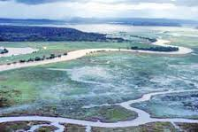
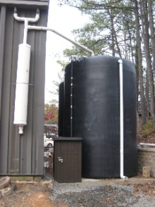
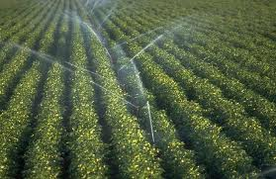
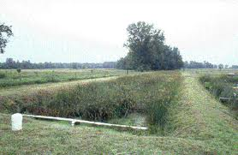
What Steps Can Be Taken to Benefit Fish and Human Health
Improve water conservation measures
    Low-flow municipal systems
    Rain-harvesting (see handout for more info)
    Reduce surface water diversions
    Improved irrigation systems – flood to sprinkler/drip
Reconnect floodplains
    Remove/modify levee system
    Create backwater, side-channel, alcove habit in mainstem
Improve water quality
    Reduce pollution into streams and rivers
    Decrease sedimentation from point and non-point sources
Opportunities for passage at major/minor dams
    Remove barriers or modify to allow passage at various flows and life histories
Wetland restoration
    Increase wetlands in the watershed
      Sediment catchment basins
      Stormwater runoff retention basins
      Decrease
Reduce encroachment into riparian areas
      County General Plans
Improve estuarine habitat conditions
  Water Quality
  Habitat Features
Conservation easements
  Decrease riparian encroachment

Slide 11
Questions ?
“One of the penalties of an ecological education is that one lives alone in a world of wounds. Much of the damage inflicted on land is quite invisible to laymen. An ecologist must either harden his shell and make believe that the consequences of science are none of his business, or he must be the doctor who sees the marks of death in a community that believes itself well and does not want to be told otherwise.”
~Aldo Leopold, A Sand County Almanac”

